Slide 1
Myntar analysis documentation
BADM-WD-E-B7
ABUTHAHEER BASHA.A

Slide 2
About Myntra
Myntra an Indian fashion e-commerce company, Established by Mukesh Bansal along with Ashutosh Lawania and Vineet Saxena.
Its headquartered in Bengaluru Karnataka, India. The company was founded in 2007-2008 to sell personalized gift items such as T-shirts, mugs, mouse pads, and others.
Myntra aims at providing a hassle free and enjoyable shopping experience to shoppers across the country with the widest range of brands and products on its portal.

Slide 3
Business model
2007-2008 It mainly operated on the B2B (business-to-business) model during its initial years to sell personalized gift items.
2010 Company shifted its strategy to becoming a B2C (business to customer) expanding its catalogue to fashion and life style products
2011-2012 Myntra began selling fashion and lifestyle products, offered products from 350 Indian and International brands.
2014 Myntra was acquired by Flipkart. Portfolio included about 1,50,000 products of over 1,000 brands.

Slide 4
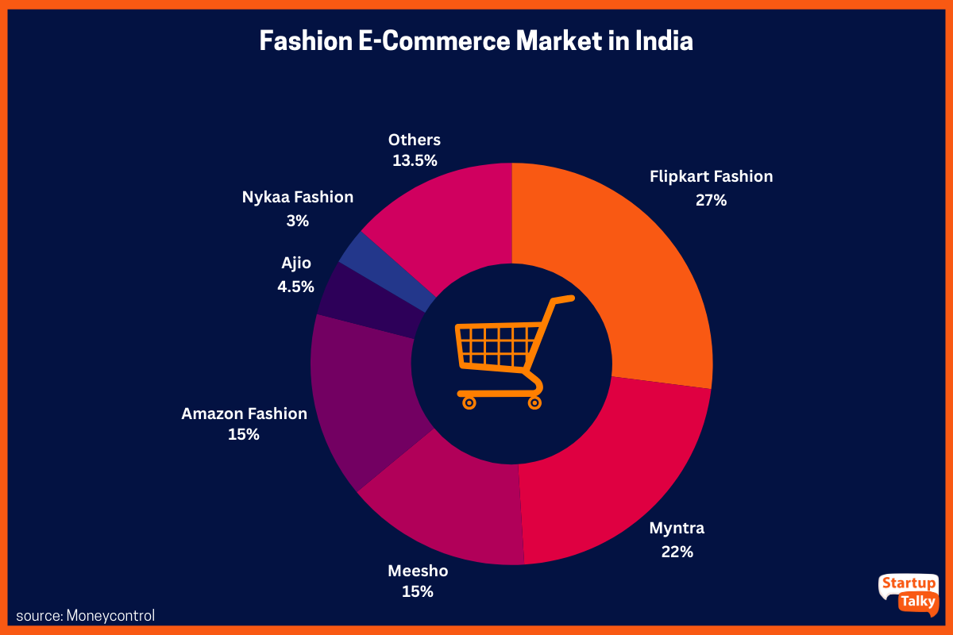
Myntra has a diverse mix of marketing strategies to reach customers. It makes an effort to offer the most up-to-date styles to customers of all ages and tastes. To boost sales and brand recognition, leverage partnerships and collaborations. Myntra partners with several fashion and lifestyle brands to provide its customers with a broad selection of products. These partnerships assist Myntra in expanding its product offerings, strengthening its brand, and increasing sales.

Slide 5
Consumers Feedback
As per the reviews that are been posted in social medias and other website the most common issues that the consumers address.
Pricing and Discount Transparency
Product Quality Issues
Delayed or Inconsistent Delivery
Issues with Returns and Refunds
Customer Support Problems
Packaging Issues

Slide 6
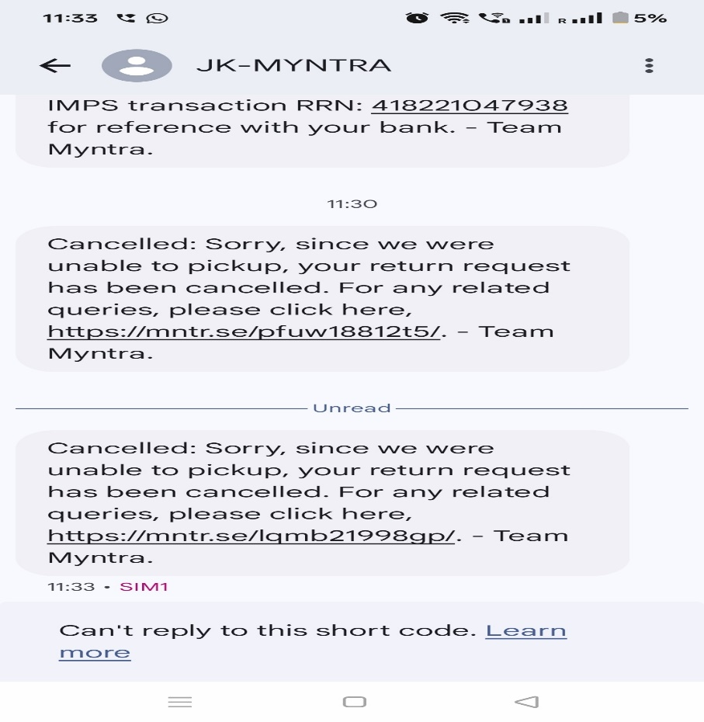
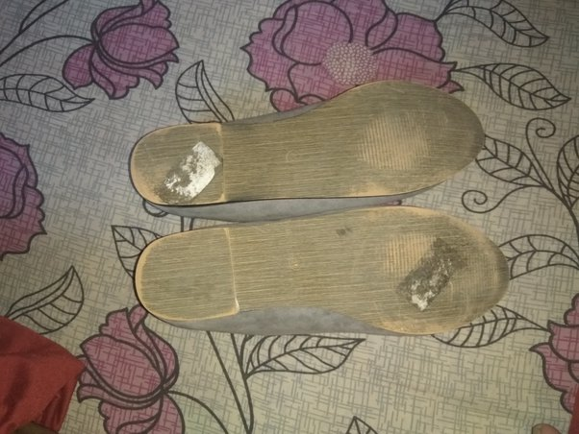
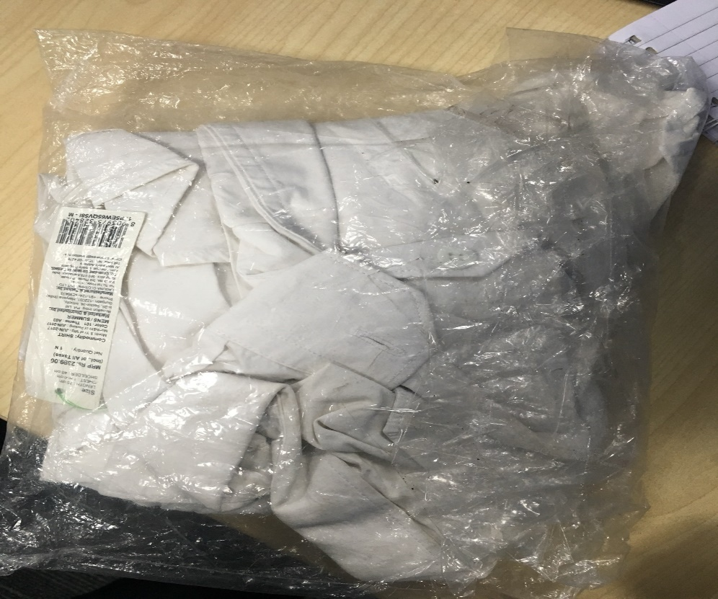
. I understood your explanation regarding VAT.
If you are so concerned about customer satisfaction, and having known that more than 19% discount would make the consumer pay more, why would you try to give 20% (foryou20 coupon) instead of 19%(for which even consumer is NOT required to pay more) .
By this incident, I don't trust Myntra from now.

Slide 7
Satisfaction Metrics
Satisfaction Areas:
Product Variety and Availability
User Experience and Design
Discounts and Sales
Moderate Areas:
Product Quality
Delivery Service
Returns and Refunds
Dissatisfaction:
Customer Service
Pricing Transparency
Stock Availability

Slide 8
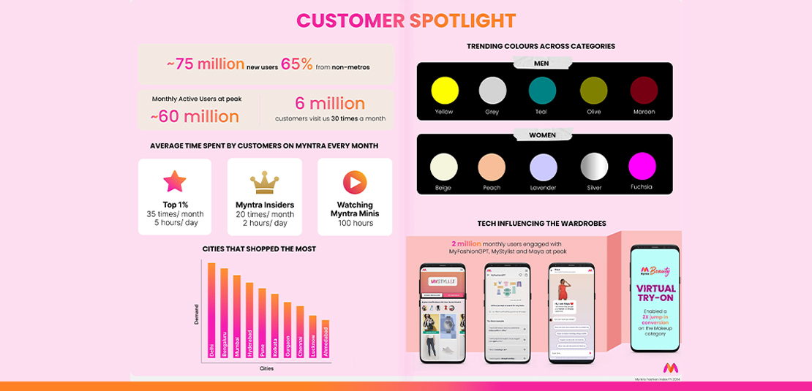
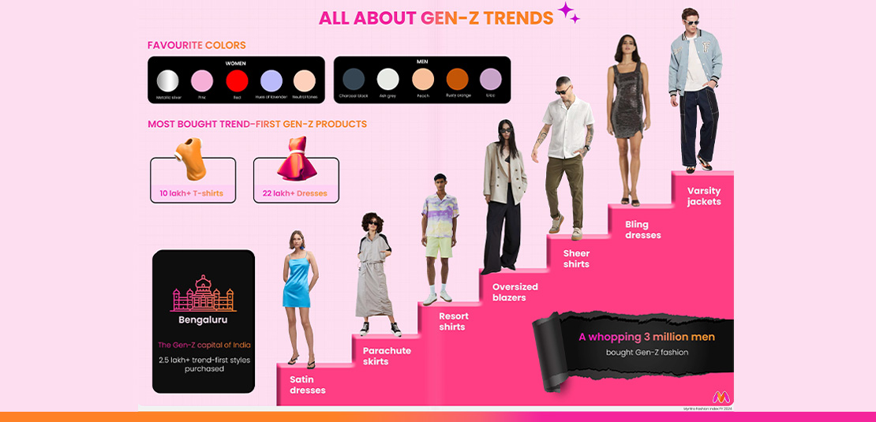

Slide 9
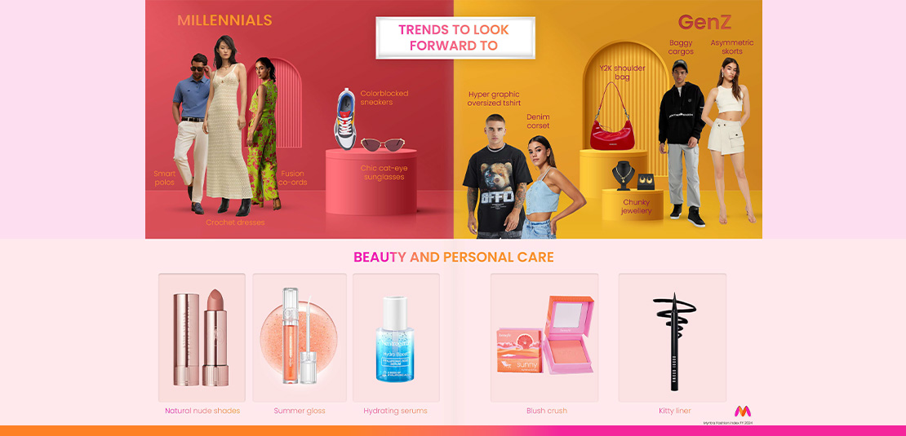
Myntra regularly keep up with emerging fashion trends to stay ahead in the fast paced fashion industry, its main demographic cohort Gen Z has nearly doubled its customer base, growing from over 8 million to an impressive 16 million. Myntra emerges with choices, gender-fluid styles, and a revival of Y2K aesthetics. They embrace oversized loungewear, statement accessories, techwear, minimalist looks, athleisure, DIY projects, and street wear influences.

Slide 10
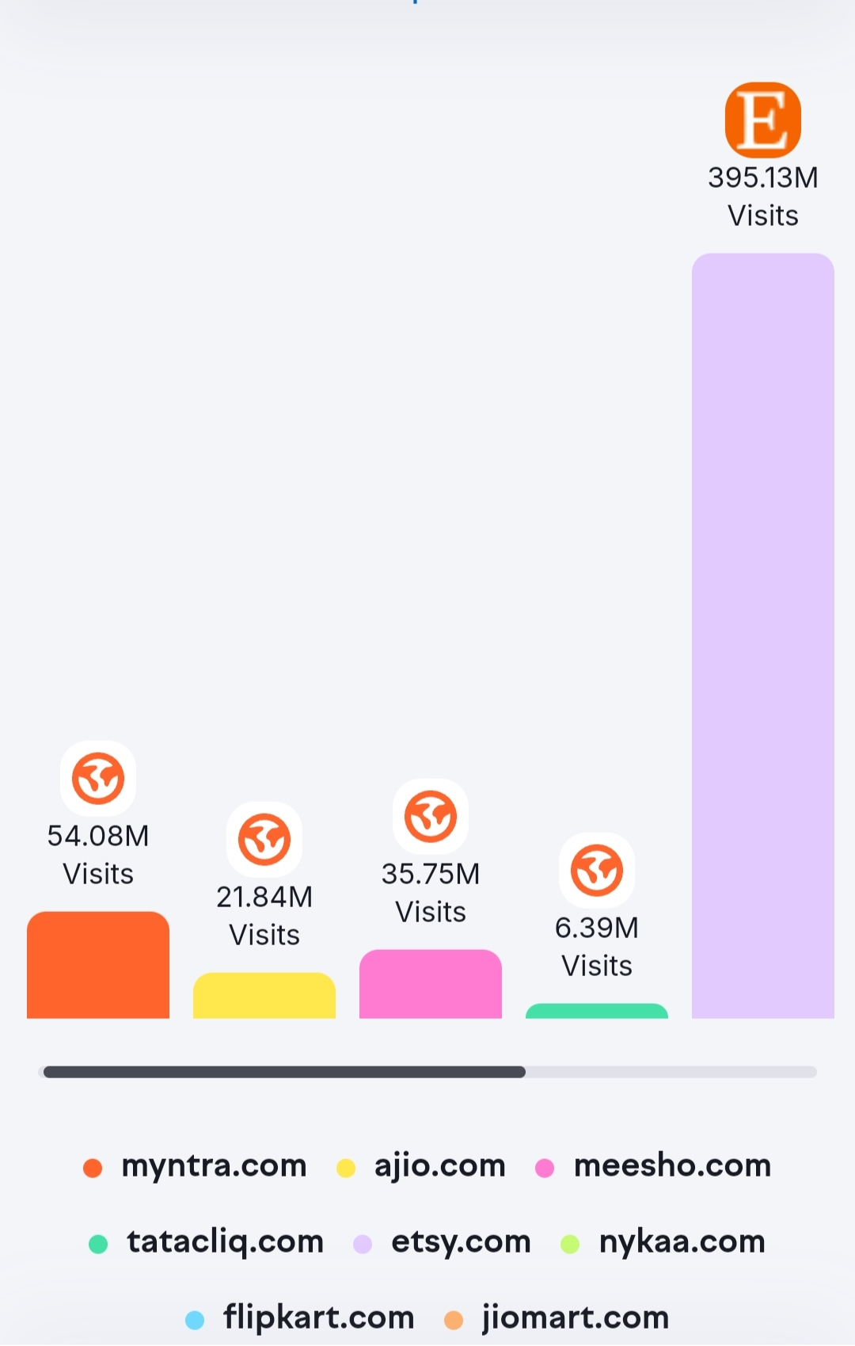
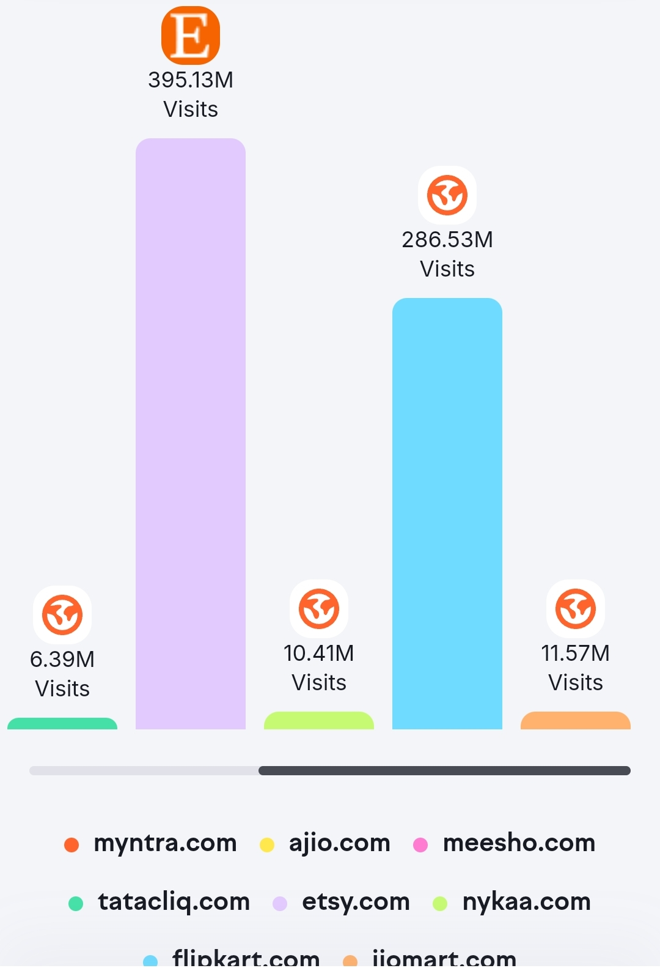
Monthly visits of mynta vs competitors

Slide 11
Competitive advantages
Strong Brand Recognition
Diverse Product Portfolio
Exclusive Brands and Collaborations
Robust Technology & User Experience
Efficient Supply Chain and Logistics
Loyalty Program (Myntra Insider)
Regular Sales and Discounts
Customer Service
In-house Brands
Data Analytics
Acquisition of Competitors
Backed by Flipkart

Slide 12
Myntra Strategies
The company also has its own private brand labels, such as Mast & Harbour, HRX, and Roadster.
Myntra also houses 25+ iconic international brands under its '#JustArrived' campaign.
Myntra's email marketing campaigns extend beyond a one-size-fits-all approach.
Myntra works with a wide spectrum of influencers, including A-list celebrities, up-and-coming content creators, and fashion bloggers, to create captivating content and advertise its products.
Myntra sponsorship of the Chennai Superkings squad in the Indian Premier League, the company is continuously seeking new ways to engage with its audience.
To pique the attention of its target audience Myntra has enlisted the help of several celebrities

Slide 13
S.W.O.T
Strength:
Diverse inventory with 50000+ brands.
Effective supply chain network reaches 90,000+ locations.
Reliable tech and user interface.
Weakness:
Dependence on Indian market.
High operating costs.
Intense competitors.
Opportunities:
Expansions into international market.
Bridal market in India is ripe for exploration.
Leverage parent company network Flipkart.
Threats:
Challenges in expanding consumer base against amazon.
Shifts in consumers preferences.

Slide 14
Recommendations
Utilize data and analytics to comprehend customer preferences and customize marketing initiatives.
Creating social media campaigns and offers that are particularly targeted to their audience using the latest technologies.
Optimizing data-driven marketing strategy to connect with and engage with customers.
To foster loyalty and keep customers, make investments in customer happiness and service.
Put forth great importance on customer satisfaction and provides a variety of services, including simple returns and exchanges, quick shipping, and dependable customer support, to ensure a positive shopping experience.

Slide 15
Sources
https://startuptalky.com/myntra-business-model
https://www.quora.com
https://www.owler.com/company
https://buildd.co/marketing
https://www.appbenny.com/post/gen-z-fashion-trends-shop-outfits-accessories-style-celebrity
https://blog.myntra.com/spotlight-on-style-myntras-trend-index-report-maps-indias-latest-fashion-trends/

Slide 16
THANK YOU

